Slide 1

Workshop Name: Intro to Data Science w/ Python
Workshop Host:
Tashi T. Gurung
Notes:
Hello folks, Welcome to the workshop. I hope you guys are enjoying the Hackathon so far.
My name is Tashi. And today, we’ll be looking at a short presentation… that will cover a high-level overview of, the field of data science.
And spend the remaining time on a hands-on mini coding project…
I will share these slides with all participants …so don’t worry.

Slide 2
What is Data Science?
Google Search: Data Science is an inter-disciplinary field, that uses [different tools] scientific methods, processes, algorithms and systems to extract knowledge and insights from many structural and unstructured data.
Google Trends
Notes:
If you do a quick google search, you will notice that there is no one definition, but most are a variety of what we have here…
[Read the presentation]
This is a very general definition, and
You will not find a definition more specific than this, because the field of DS itself is very young.
Let us go to google trends right now and look for data science
Choose the maximum time range available, which seems to be since 2004 to present, this is what you’ll find
The “Interest over time” is steady in the first half, and really starts trending upwards…
Late 2012 and early 2013…, and it has been going up ever since….
The point being, mid length silence….
What Data Science is differs from people to people, and company to company?

Slide 3
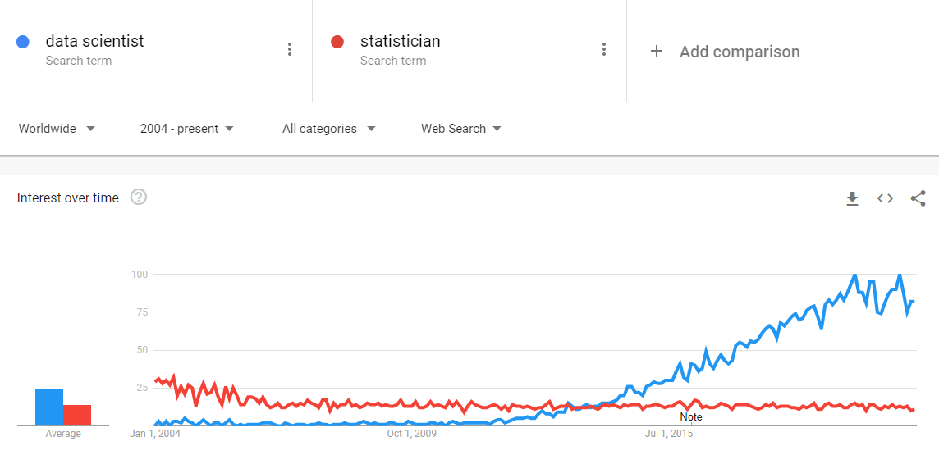
Notes:
This is a line plot I pulled off google trends. It shows how

Slide 4

What is Data Science?
Artificial Intelligence (AI)
Machine Learning (ML)
Deep Learning (DL)
Notes:
So, what is Data Science? And what is… AI ML DL? Are they the same? Are they different?
It is generally agreed that AI is the wider term that includes Machine Learning.
And deep learning is just a sub field of Machine Learning.
So it’s AI > ML > DL
And where does DS fit in?
Data Science actually overlaps all of these fields, and includes more

Slide 5
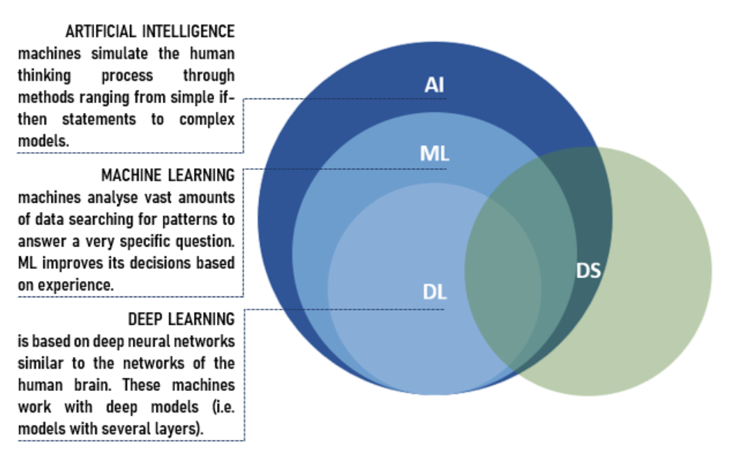
Notes:
A reminder, you will get a copy of these slides. Don’t worry too much about taking notes

Slide 6


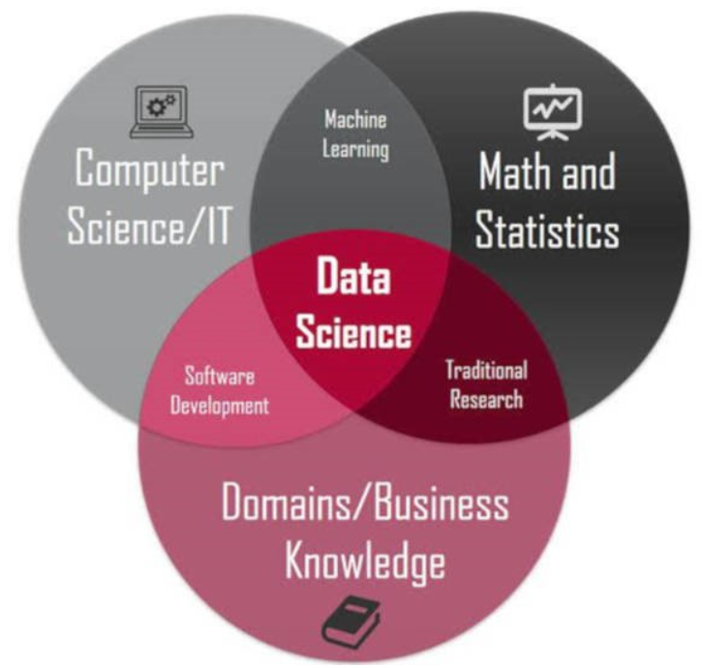

Intersection of
Computer Science
Statistics
Business
Notes:
Data Science makes use of
1st Computer Science Theory
2nd Concepts and tools from Statistics
And
3rd Business Acumen and Domain Knowledge

Slide 7
What are the different roles within the field of Data Science?
Data Analyst
Data Visualization Analyst
Business Analyst
Business Intelligence
Data Scientist
Statistician
Data Engineer
Data Architect
Database Administrator
Machine Learning Engineer

Slide 8
The Data Science Umbrella
Data Analyst
Data Scientist
Data Engineer

Slide 9
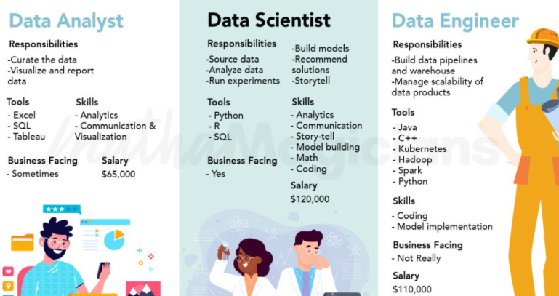

Slide 10
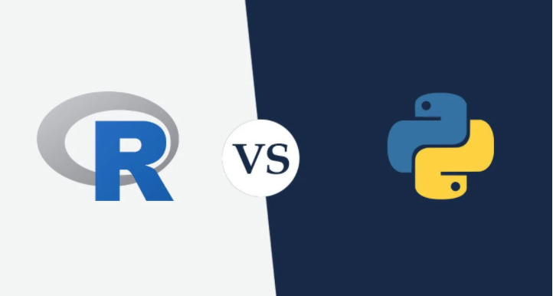
Python vs R
R is great for statistical modeling
Used in research extensively, loved by academics
Great for time-series analysis
Python is a general-purpose language.
More widely used in the industry
Better for integration and deployment
Better for Deep Learning

Slide 11

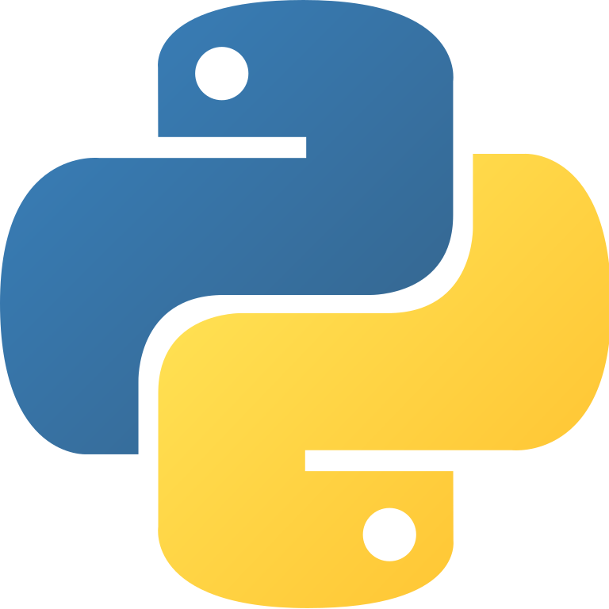

Data Science w/ Python

Slide 12




Integrated Development Environment (IDE)
Software application
Popular IDEs:
PyCharm
VS Code
Atom
Sublime Text
Notes:
What is an IDE?
It is basically a software application we can use to write code
For DS, we can use any of these classic IDEs, but for today’s workshop we will use something else

Slide 13



Jupyter Notebooks
Interactive web applications
Can consists of text, code, image and more
Is composed of two types of cells:
Code Cells
Text Cells
Anaconda Navigator
Install in local machine
Google Colab
Run Online
Notes:
It’s called Jupyter Notebooks.
What are Jupyter Notebooks?
These are interactive web applications
We can use Anaconda Navigator or Google Colab to run Jupyter Notebooks

Slide 14
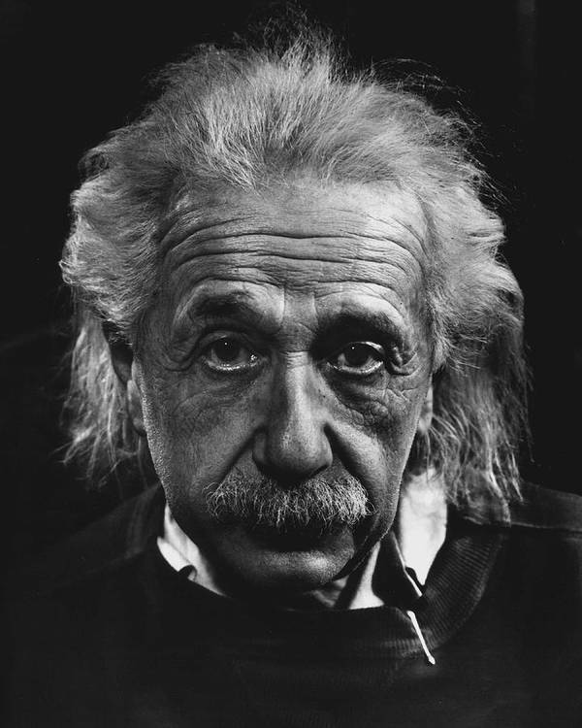
Questions?
colab.research.google.com

Slide 15

CODING TIME !!!

Slide 16
Resources:
Harvard Business Review:
Data Scientist: The Sexiest Job of the 21st Century(Oct 2012)

Slide 17
References
Images
AI vs ML vs DL: https://www.abrisconsult.com/artificial-intelligence-and-data-science/
Data Science Umbrella: https://mathamagicians.co/2020/04/06/differences-between-a-data-analyst-data-scientist-and-data-engineer/
Intersection of image: https://dzone.com/articles/why-you-should-learn-data-science-with-python-in-2

